Slide 1
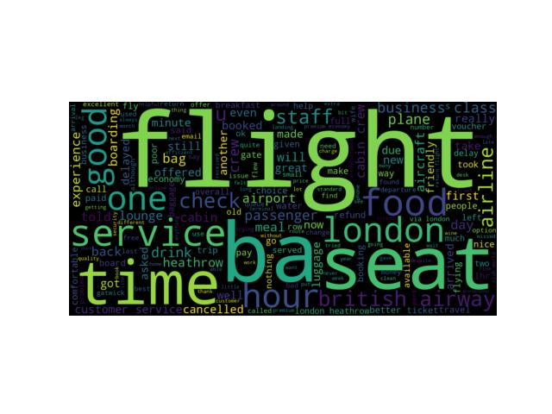

Review Analysis of BRITISH AIRWAYS
On collecting about 1,000 customers reviews via Skytrax; a sentiment analysis was conducted.
The reviews were mapped on a scale of 1 to 10.
On conducting the analysis, following findings are presented in the slides.

Slide 2
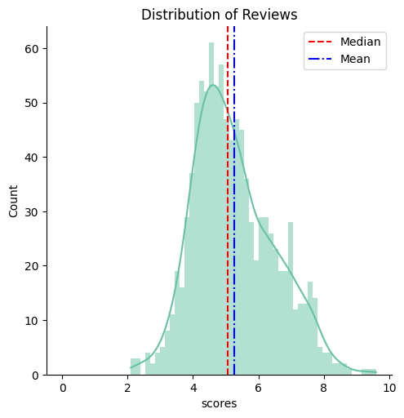
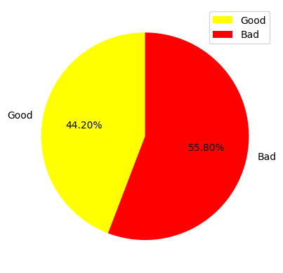
The distribution of customer reviews as stated before were scaled. The reviews now can act as a quantifiable metric to analyse customer satisfaction.
The distribution is positively skewed which suggest that most of the customers remained unsatisfied.
More than half of our customers were unsatisfied with our services. The same can be inferred from the word cloud generated through sentiment analysis.

